Slide 1
Machine Learning
MATH42815
Tuesday January 16th 2024

Slide 2
Week 2
Practical 4:
Ridge regression
Lecture 3:
Step functions, polynomials, and splines
Practical 5:
Lasso regression; maybe some PCR
Practical 6:
Step functions, polynomials, and splines
Lecture 4:
Logistic Regression and Decision Trees

Slide 3
Lecture 3 Outline
Polynomial Regression
Global or Local Fit?
Step Functions
Piecewise Polynomials
Splines
Technical Details
How many knots and where?
Spline basis representation
Advanced Spline Techniques
Specific credit: Sam Jackson

Slide 4
Polynomial Regression

Slide 5
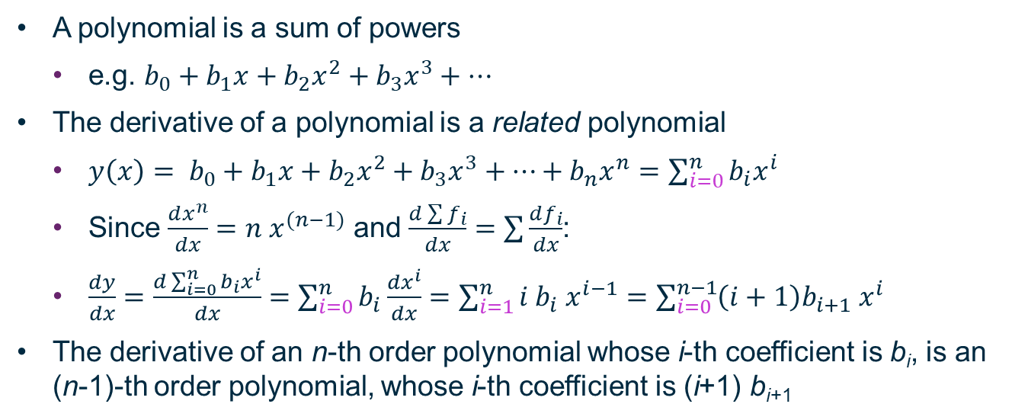
Polynomial basics
A polynomial is a sum of powers
e.g. $b_{0}+b_{1}x+b_{2}x^{2}+b_{3}x^{3}+…$
The derivative of a polynomial is a related polynomial
$y\left(x\right)= b_{0}+b_{1}x+b_{2}x^{2}+b_{3}x^{3}+…+b_{n}x^{n}=\sum_{i=0}^{n}{b_{i}x^{i}}$
Since $\frac{dx^{n}}{dx}=n{ x}^{(n−1)}$ and $\frac{d\sum{f_{i}}}{dx}=\sum{\frac{df_{i}}{dx}}$:
$\frac{dy}{dx}=\frac{d\sum_{i=0}^{n}{b_{i}x^{i}}}{dx}=\sum_{i=0}^{n}{b_{i}\frac{dx^{i}}{dx}}=\sum_{i=1}^{n}{i b_{i} x^{i−1}}=\sum_{i=0}^{n−1}{\left(i+1\right)b_{i+1} x^{i}}$
The derivative of an n-th order polynomial whose i-th coefficient is b_{i}, is an (n-1)-th order polynomial, whose i-th coefficient is (i+1) b_{i+1}

Slide 6
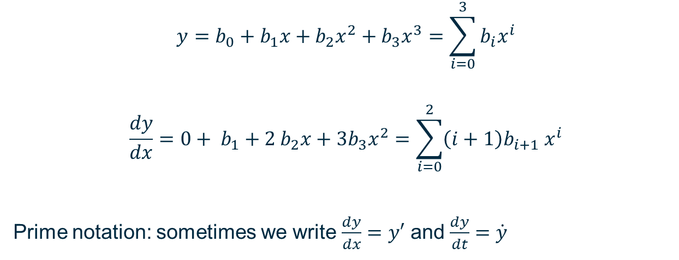
Simple Example
$$y=b_{0}+b_{1}x+b_{2}x^{2}+b_{3}x^{3}=\sum_{i=0}^{3}{b_{i}x^{i}}$$
$$\frac{dy}{dx}=0+ b_{1}+2 b_{2}x+3b_{3}x^{2}=\sum_{i=0}^{2}{\left(i+1\right)b_{i+1} x^{i}}$$
Prime notation: sometimes we write $\frac{dy}{dx}=y′$ and $\frac{dy}{dt}=\dot{y}$

Slide 7
Why Use Polynomial Regression?
We have focused on linear relationships for a few reasons
Many of the techniques extend to non-linear relationships
Linear models are linear in the coefficients – the linearity of the predictor variables is irrelevant
Under many circumstances, relationships are approximately linear
If we have strongly non-linear relationships between our predictor variables and our output variables, we may choose polynomial regression
Depending on the relationship and the data, there may be better options available (as we shall see later in this lecture!)

Slide 8
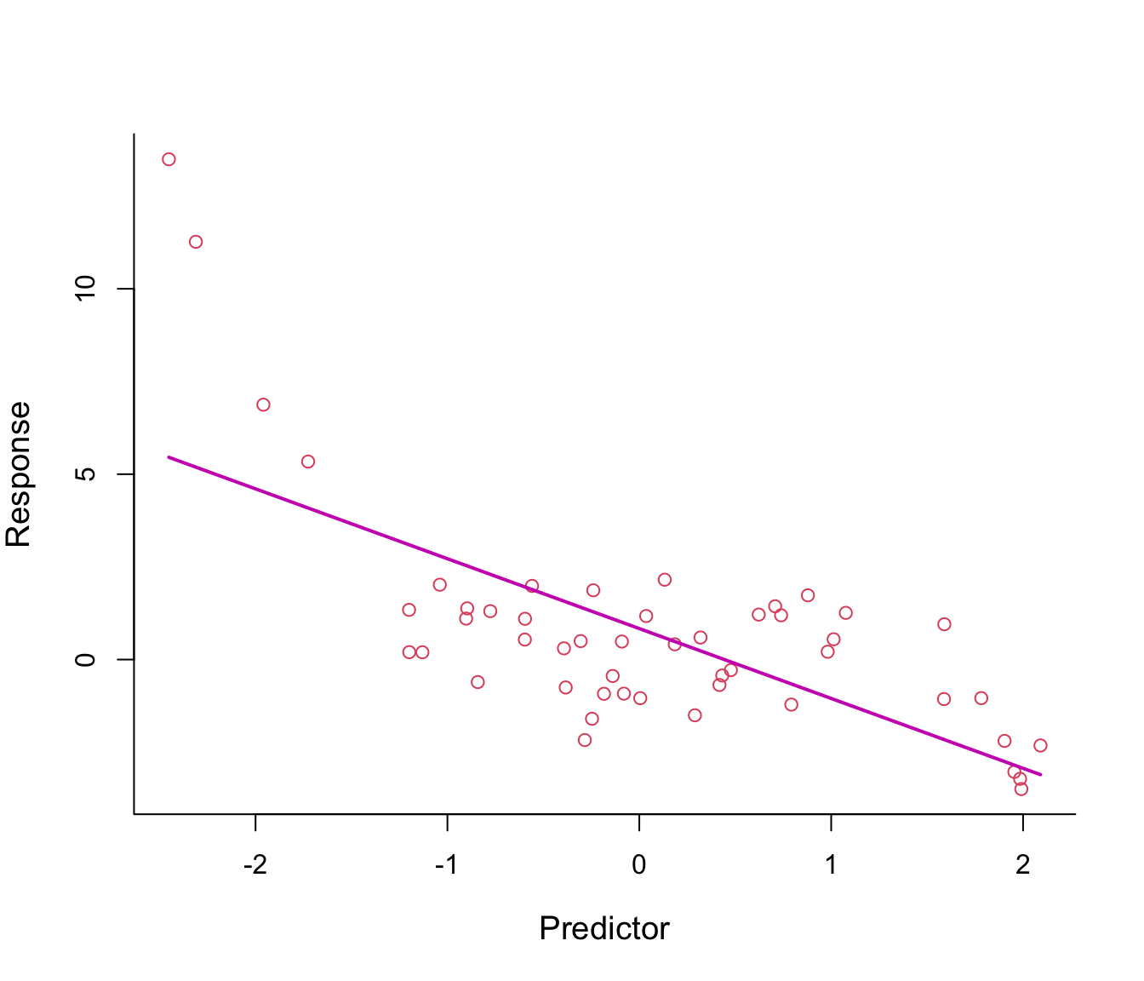
Highly Non-Linear Relationship
Sam Jackson

Slide 9
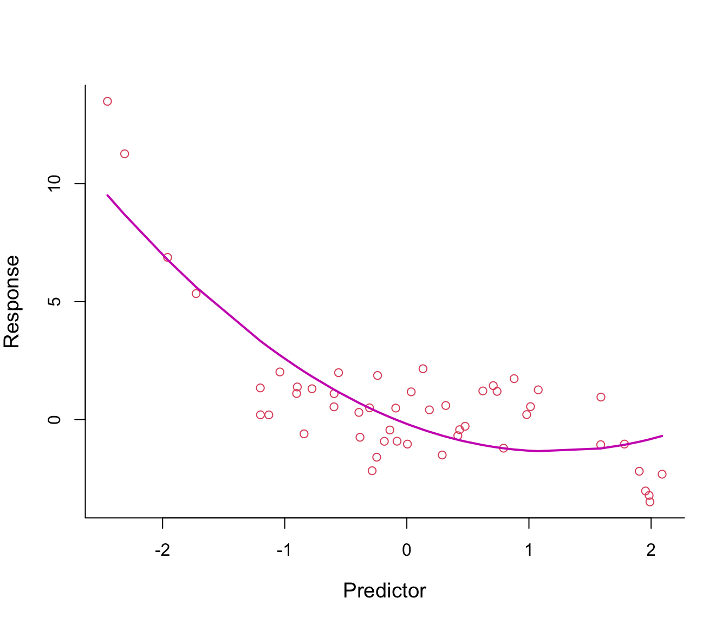
Need to Determine Suitable Order Polynomial
Sam Jackson

Slide 10
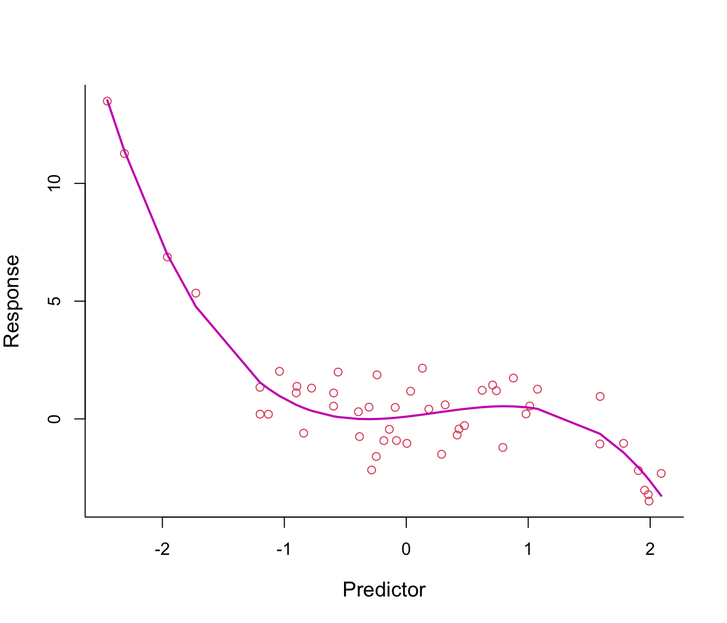
Cubic Polynomial Fit
Sam Jackson

Slide 11
What Order Polynomial?
Usually, up to third order polynomial
Because of the risk of overfitting, it is vital to cross-validate a higher-order polynomial model
Every extra power of x is essentially adding a “new” variable to a multi-linear fit, even though you started with just one predictor variable
All of the predictor variables will correlate!
If trying to explain behaviour, I would recommend using a parsimonious model (i.e. be very hesitant to add a new variable)
If using a non-parametric model in machine learning, we would need to automate this process – which can be problematic as the machine lacks context

Slide 12
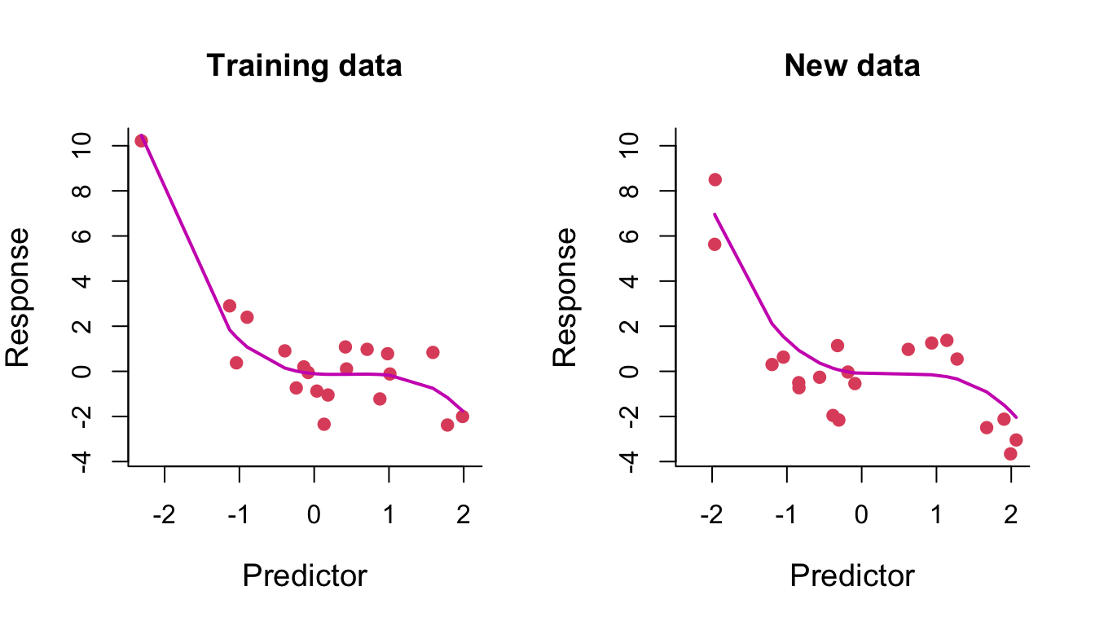
Overfitting with High-Order Polynomials (p=3)
Sam Jackson

Slide 13
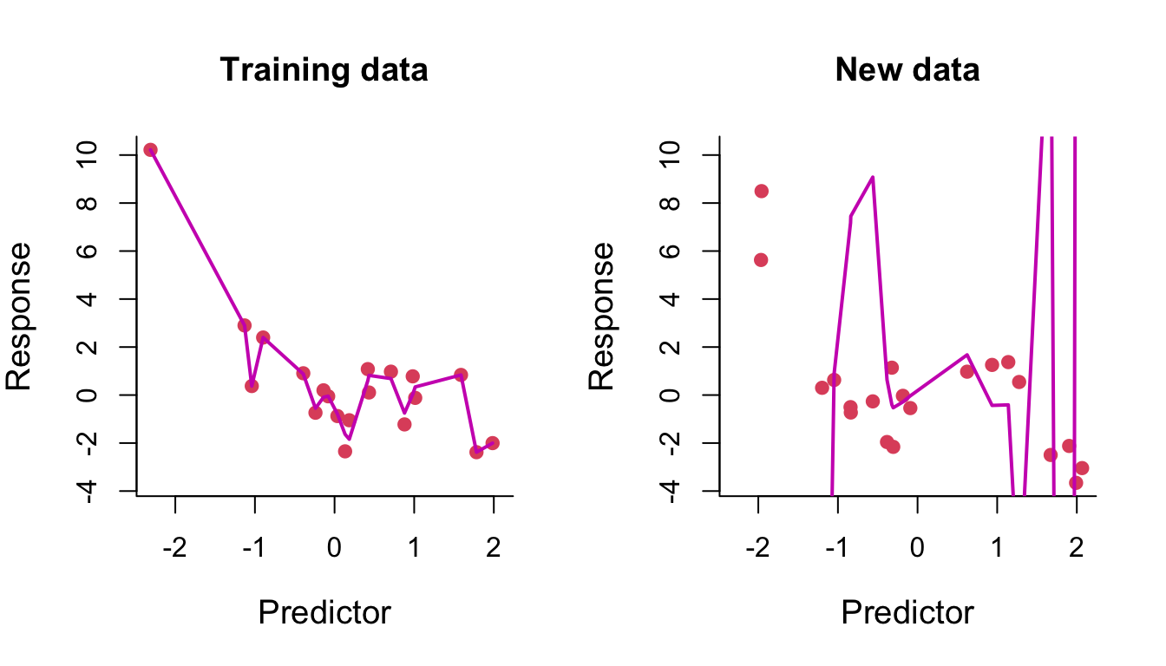
Overfitting with High-Order Polynomials (p=14)
Sam Jackson

Slide 14
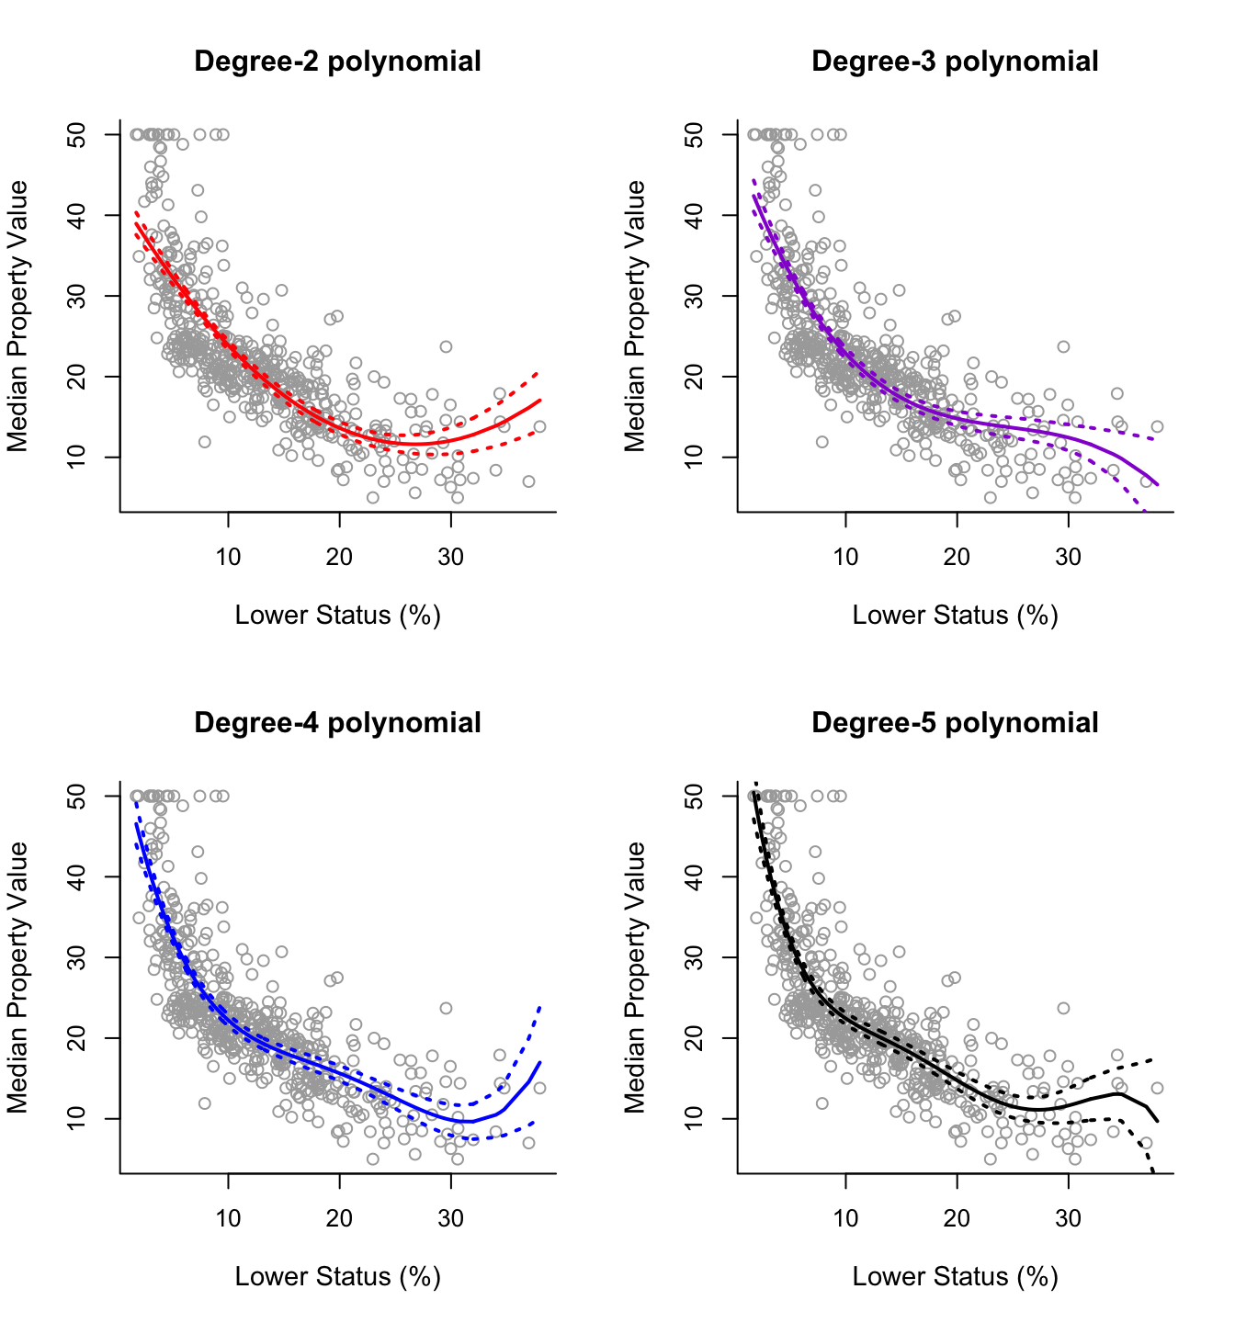
Sam Jackson

Slide 15
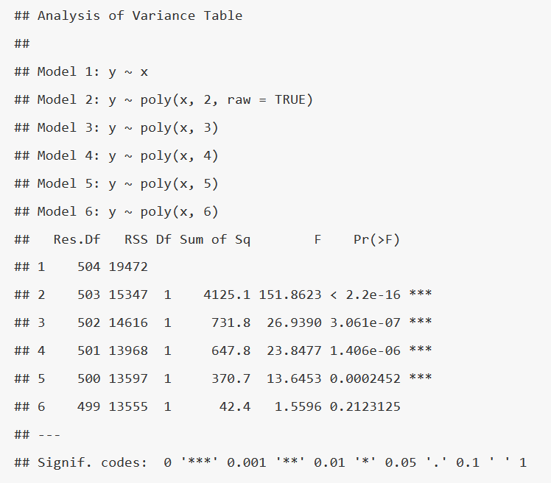

Slide 16
Sam Jackson

Slide 17
Fit Global or Local?

Slide 18
Assumption So Far: Fit Global
Advantage: Uses all data!
Largest possible training data set influencing behaviour at every point
Not always a good idea!
Sometimes, value of output variable really only depends on local values of input variable
Easiest example: time dependency
Height of growing trees
Not every time dependency is specifically local, e.g. used car prices will largely be linear in terms of age
How to represent this behaviour in a model?

Slide 19
Most Basic: Step Functions
Divide range of input/feature variables into suitable intervals
Dividing points: “cut-points”
Return mean value of output variable within each of these intervals
Essentially a piecewise null model
Questions to answer:
How many cut-points?
Where to put them?

Slide 20
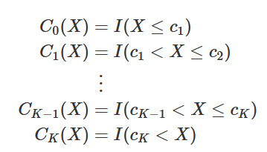
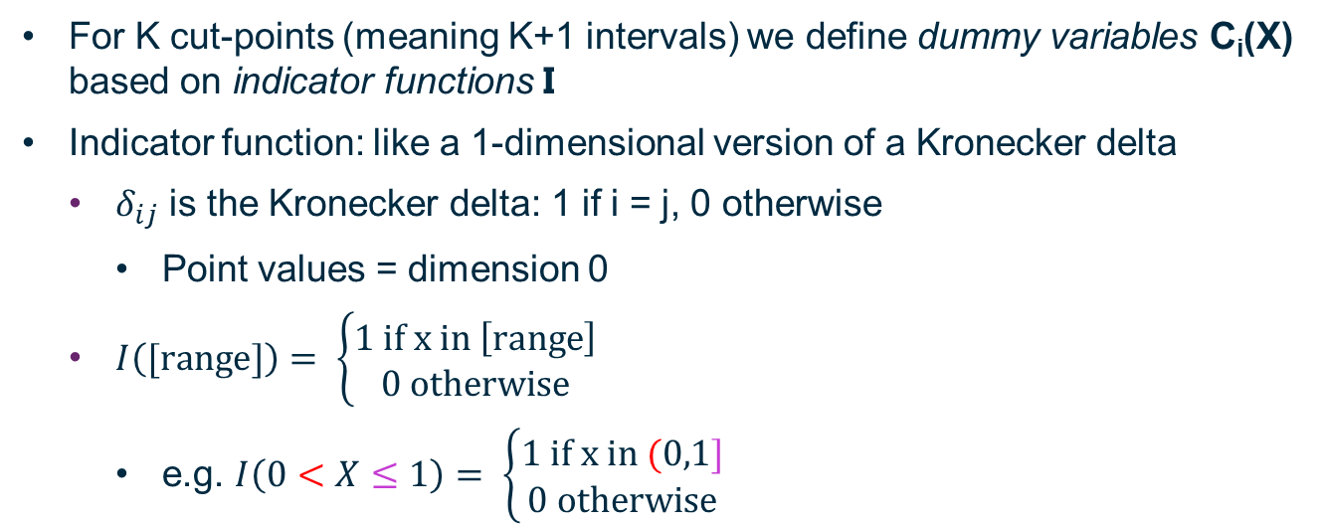
Creating Dummy Variables
For K cut-points (meaning K+1 intervals) we define dummy variables C_{i}(X) based on indicator functions I
Indicator function: like a 1-dimensional version of a Kronecker delta
$δ_{ij}$ is the Kronecker delta: 1 if i = j, 0 otherwise
Point values = dimension 0
$I\left([range]\right)= \left\{\begin{matrix}1 if x in \left[range\right] \\ 0 otherwise\end{matrix}\right.$
e.g. $I\left(0<X≤1\right)= \left\{\begin{matrix}1 if x in (0,1] \\ 0 otherwise\end{matrix}\right.$

Slide 21
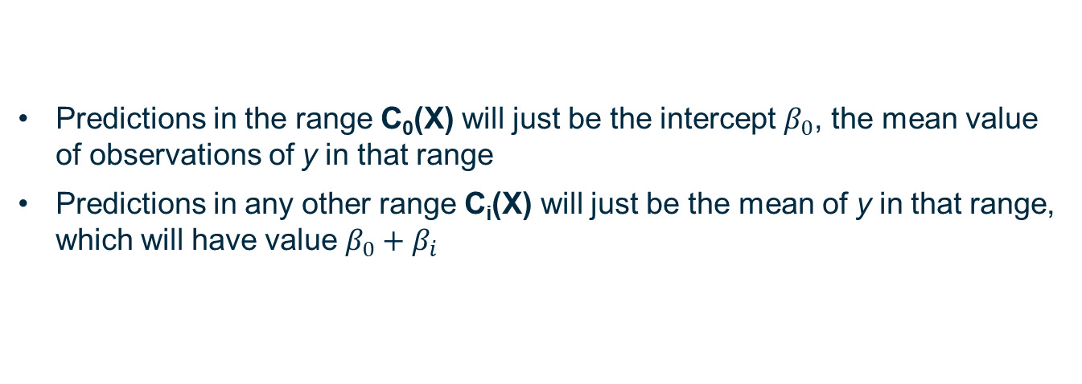
Fit Stepwise Model Using Dummy Variables: Theory
Predictions in the range C₀(X) will just be the intercept $β_{0}$, the mean value of observations of y in that range
Predictions in any other range C_{i}(X) will just be the mean of y in that range, which will have value $β_{0}+β_{i}$

Slide 22
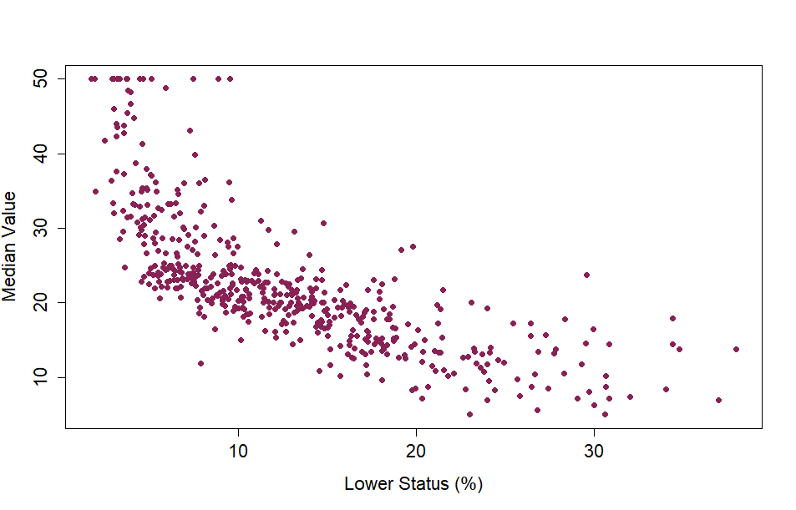
Boston data: Median Value versus Lower Status

Slide 23
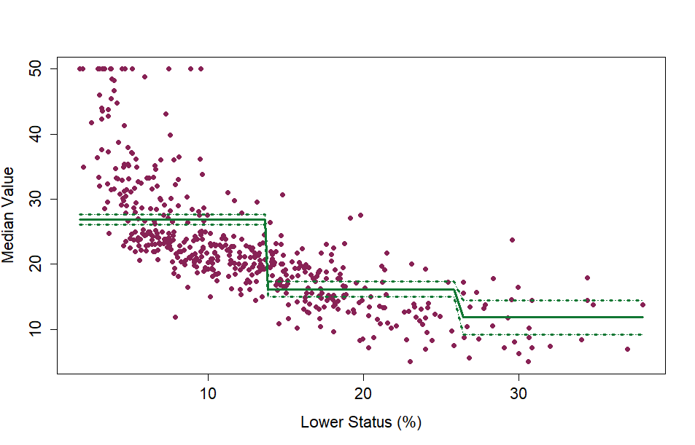
Step Function with 2 Cut Points (3 Ranges)

Slide 24
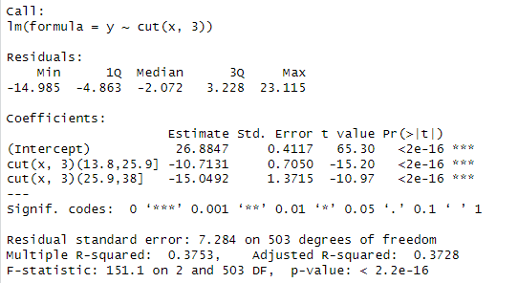

Fit Stepwise Model Using Dummy Variables: Example
R has automatically chosen cut-points for you based on the distribution of values of X
In this case, cut-points at 13.8 and 25.9 – roughly 1/3 and 2/3 of the way through the data set
Intercept value is mean of y-values for X < first cut-point
Other coefficients are difference between intercept and means in other intervals/ranges

Slide 25
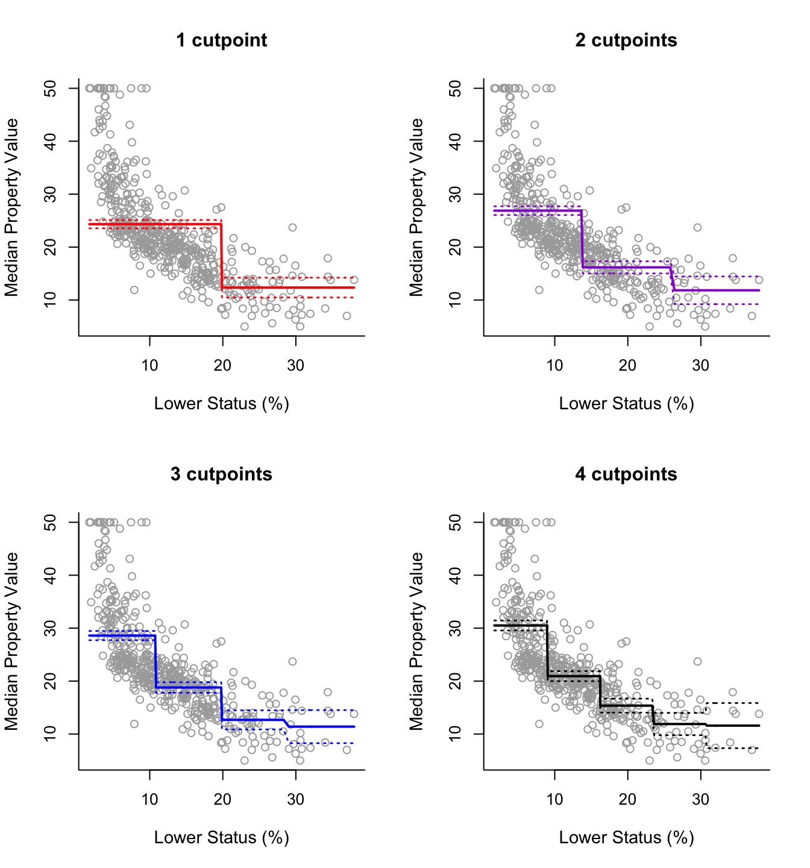
Sam Jackson

Slide 26
Piecewise Polynomials

Slide 27
Piecewise Polynomials
Instead of just returning mean/null model, what happens if we fit polynomials in a piecewise fashion?
Can anyone think of problems we can run into?
Smaller training data within each region, since only considering local data
One other major issue

Slide 28
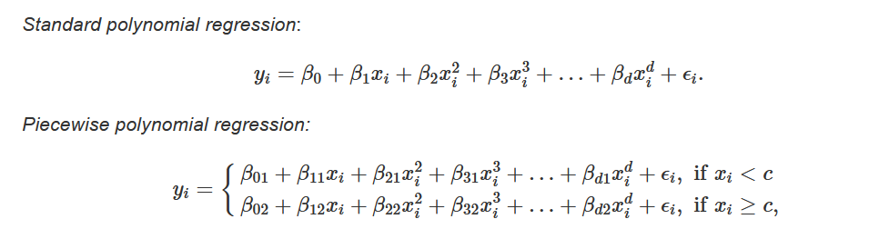
Formula for Piecewise Polynomial
Number of knots (cut-points): K (=1 in this example)
Highest order of polynomial: d

Slide 29
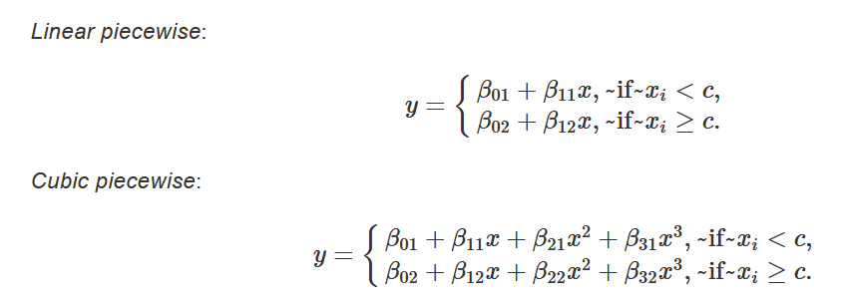
Specifics: Linear and Cubic
Number of knots (cut-points): K (= 1 in this example)
Highest order of polynomial: d (= 3 in this example)

Slide 30
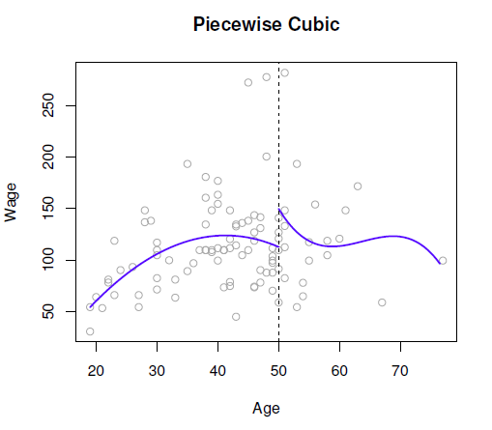
Simple example: two regions
Sam Jackson

Slide 31
Piecewise Polynomials
Instead of just returning mean/null model, what happens if we just fit polynomials in a piecewise fashion?
Can anyone think of problems we can run into?
Smaller training data within each region, since only considering local data
Discontinuities at knots (change in terminology: “cut-points” for stepwise)

Slide 32
Splines

Slide 33

Avoiding discontinuities at knots
We like smooth functions without discontinuities
Step functions: discontinuities are acceptable, hence term cut points
Splines: discontinuities are unacceptable, and so the ends of our piecewise polynomials are effectively tied together
Hence term knots
How do we tie our functions together in practice?

Slide 34
At each (i-th) knot, make f_{i-1} = f_{i}
Constrains the value of one of the coefficients
Removes a degree of freedom from the model

Slide 35
Simple example: two regions
Sam Jackson

Slide 36
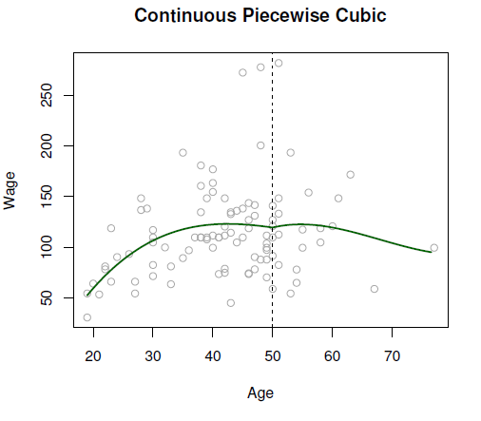
Simple example: two regions, continuous
Sam Jackson

Slide 37
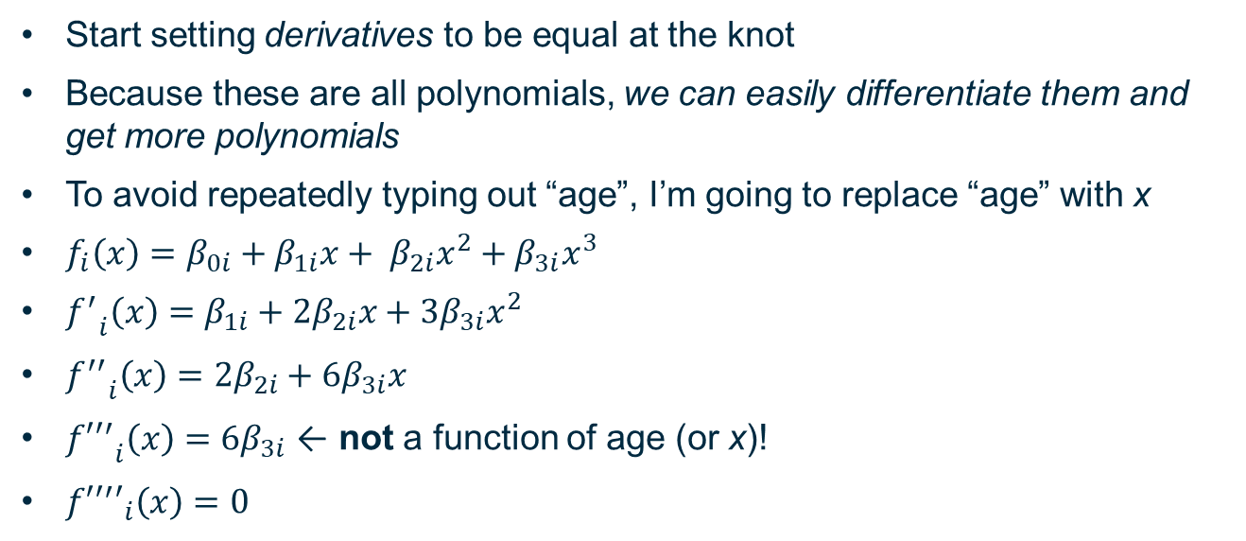
Let’s make it even smoother
Start setting derivatives to be equal at the knot
Because these are all polynomials, we can easily differentiate them and get more polynomials
To avoid repeatedly typing out “age”, I’m going to replace “age” with x
$f_{i}\left(x\right)=β_{0i}+β_{1i}x+ β_{2i}x^{2}+β_{3i}x^{3}$
${f^{′}}_{i}\left(x\right)=β_{1i}+2β_{2i}x+3β_{3i}x^{2}$
${f^{′′}}_{i}\left(x\right)=2β_{2i}+6β_{3i}x$
${{f′′}^{′}}_{i}\left(x\right)=6β_{3i}$ ← not a function of age (or x)!
${{f′′}^{′}′}_{i}\left(x\right)=0$

Slide 38
Splines: Smooth, constrained piecewise polynomials
Definition: A degree-d regression spline is a piecewise polynomial of degree (highest power of x) d, with continuity in derivatives up to degree d−1 at each knot
See Intro to Statistical Learning with Applications in R, on the reading list
The degrees of freedom of a degree-d regression spline with K knots are (d + 1) + K.
The degrees of a freedom of a degree-d piecewise polynomial with K cut-points are (d + 1) * (K + 1)
Much more prone to overfitting!
In addition to discontinuity issue

Slide 39
Simple example: two regions
Sam Jackson

Slide 40
Simple example: two regions, continuous
Sam Jackson

Slide 41
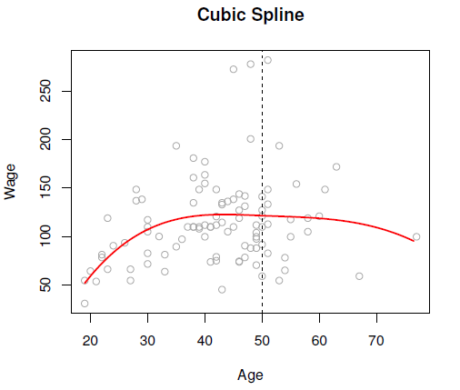
Simple example: two regions, cubic spline
Sam Jackson

Slide 42
Technical Details

Slide 43
How Many Knots, and Where?
Creating spline model “by hand”
Can examine data and choose location of knots
Knot where you see a clear change in behaviour of output variable
More knots in less “stable” regions
Risk of overfitting
Smaller data sets
Computer: has to automate things
Will often do so uniformly
Could be instructed to ensure minimum number of data points in a range, higher density of knots in region where output variable changes quickly…

Slide 44
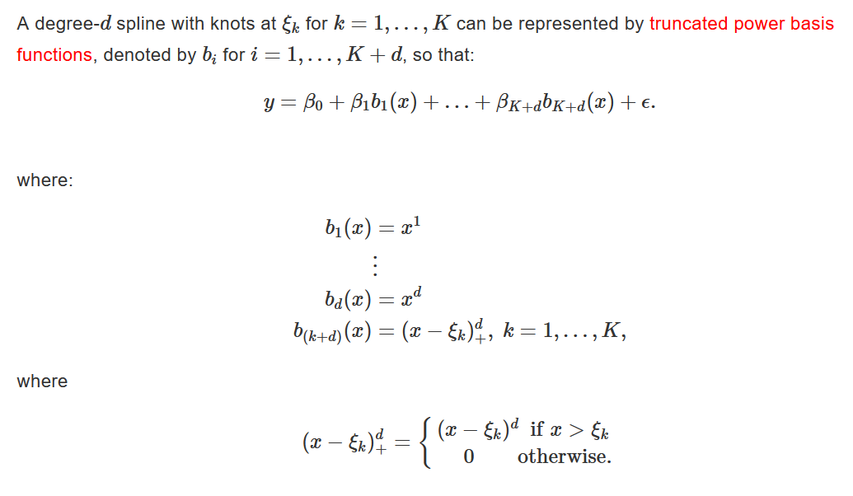
Spline Basis Representation: Theory
Sam Jackson

Slide 45
Spline Basis Representation: Practice
Previous slide’s equivalent to raw=TRUE option for poly() function
When we make use of inbuilt R functions, a different representation is used: B-splines
If you want to know more, see here or here
Key take-home points:
You can represent splines using the basis set shown on the previous slide
It is easier to interpret, but less computationally efficient
Trade-off!
Use predict() to work out spline model values!

Slide 46
Even Better Spline Varieties!

Slide 47
Natural Splines

Slide 48
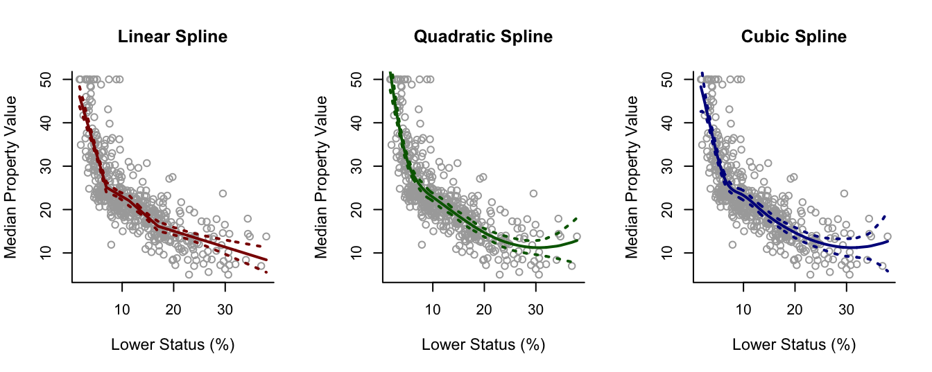
Problems on the Edge
Confidence intervals large and variable at tails (near ends of X range)

Slide 49
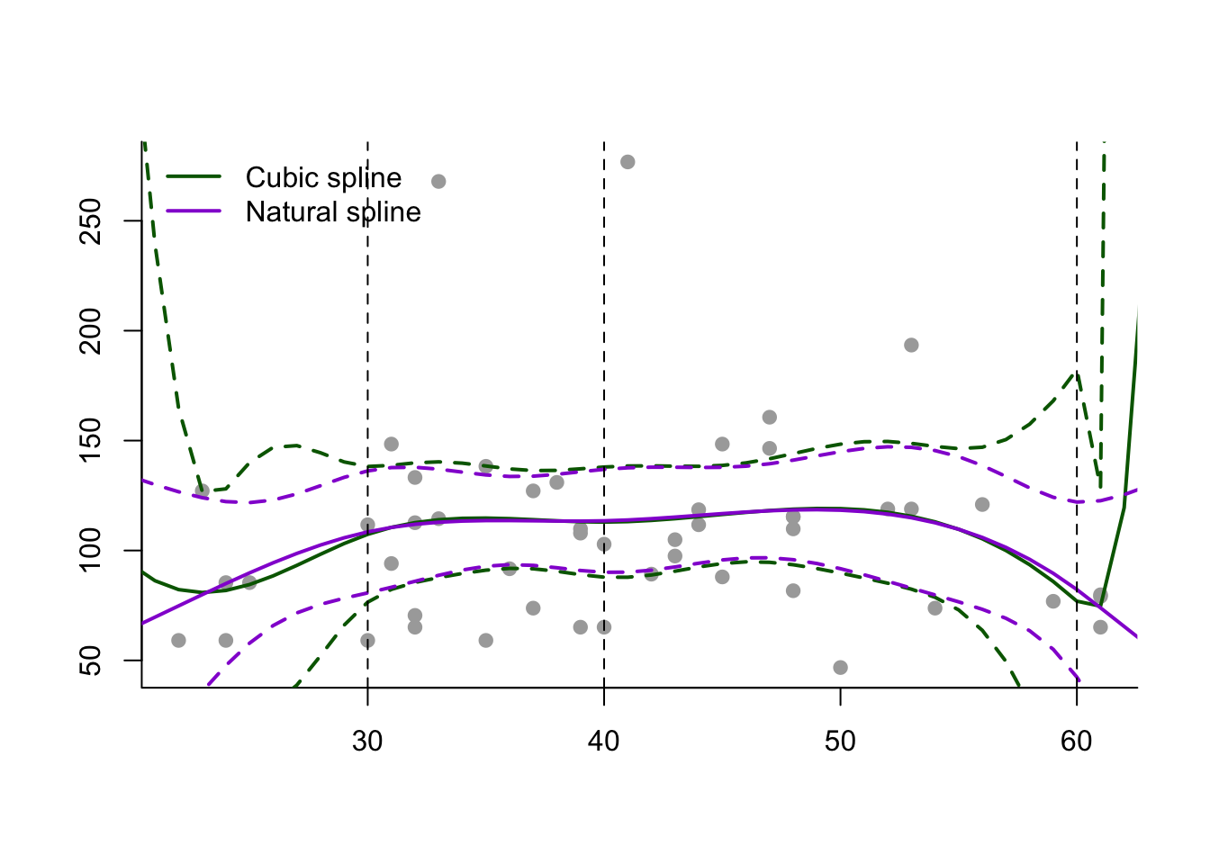
Natural Splines
Declare that below the lowest knot and above the highest knot, function constrained to be linear (ish)

Slide 50
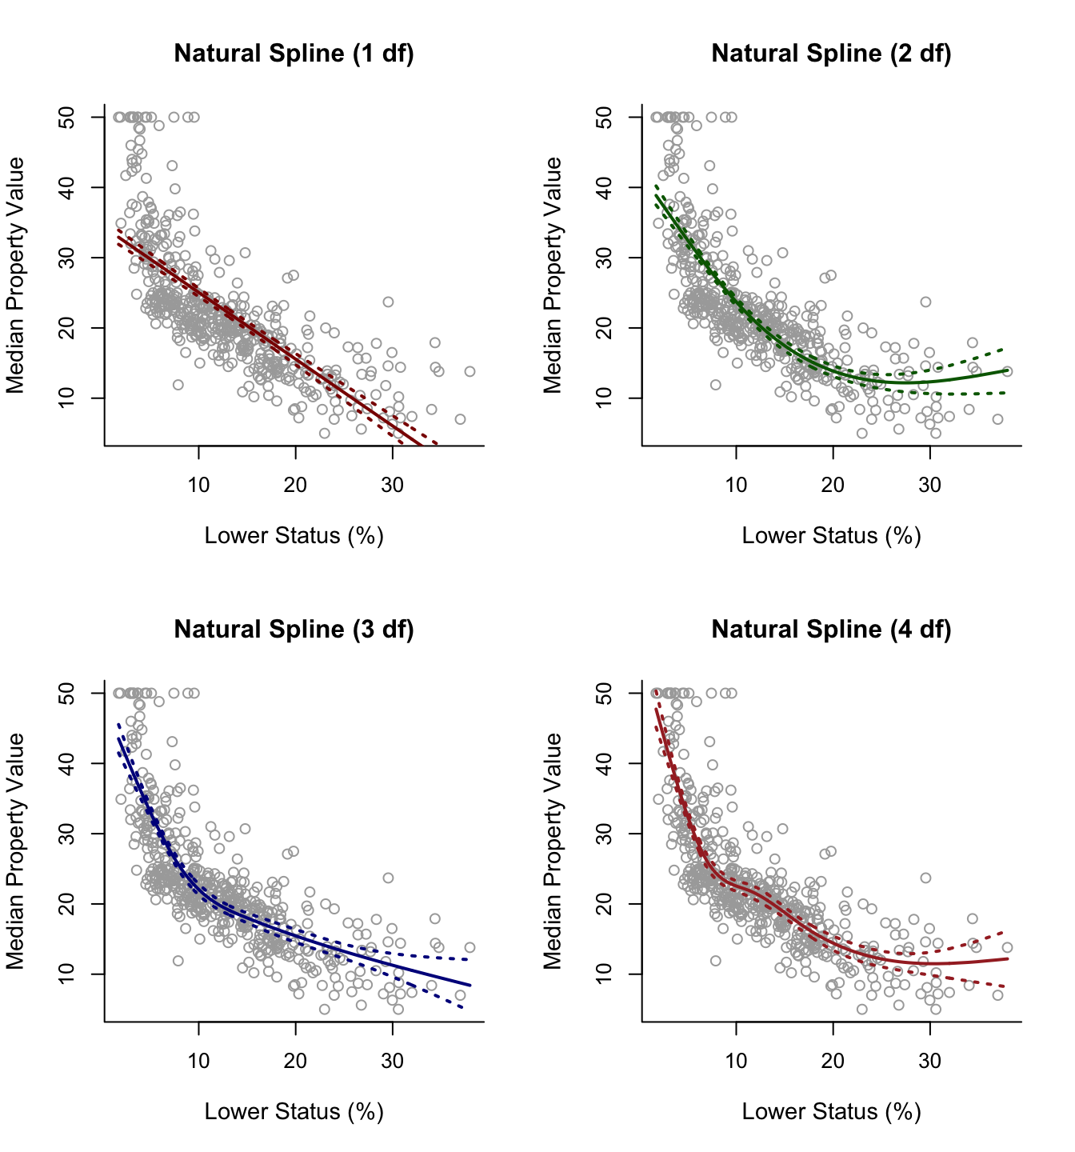

Slide 51
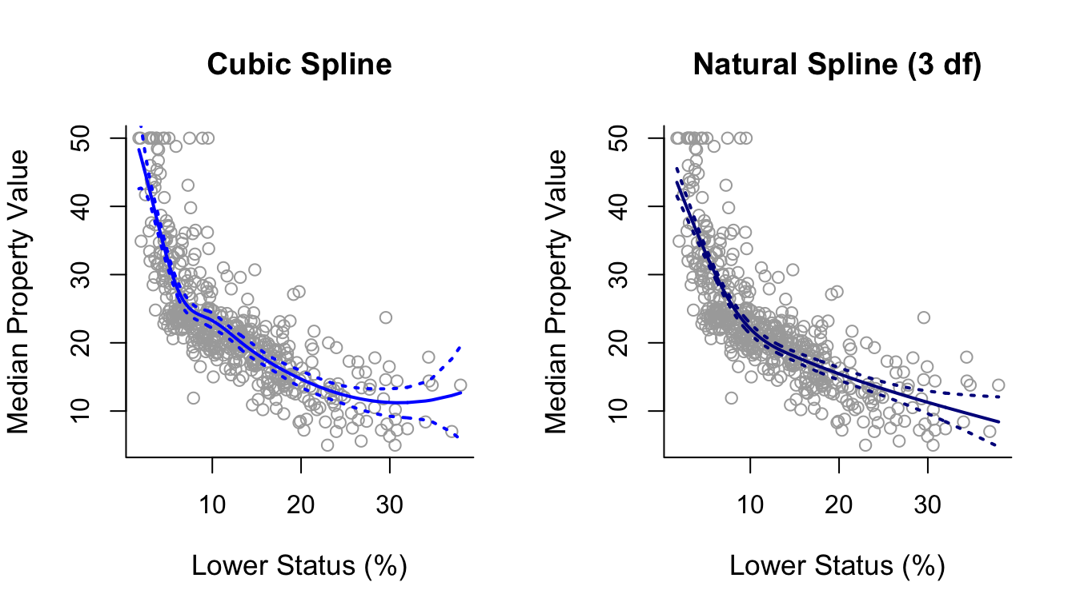
What happens if we remove the “bad” data where medv = 50?

Slide 52
Smoothing Splines

Slide 53
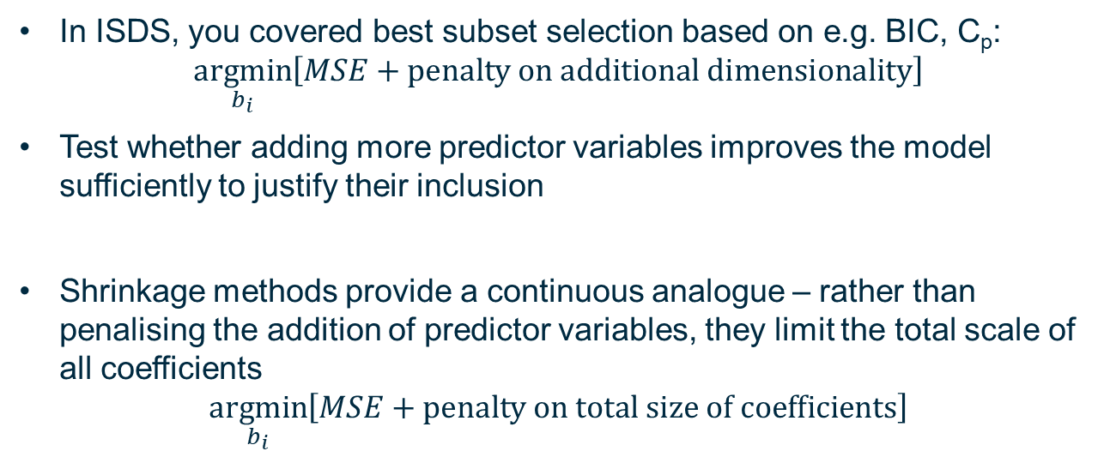
Continuous penalty on additional predictors
In ISDS, you covered best subset selection based on e.g. BIC, C_{p}: $\underset{b_{i}}{argmin}\left[MSE+\text{penalty} \text{on} \text{additional} \text{dimensionality}\right]$
Test whether adding more predictor variables improves the model sufficiently to justify their inclusion
Shrinkage methods provide a continuous analogue – rather than penalising the addition of predictor variables, they limit the total scale of all coefficients
$$\underset{b_{i}}{argmin}\left[MSE+\text{penalty} \text{on} \text{total} \text{size} \text{of} \text{coefficients}\right]$$

Slide 54

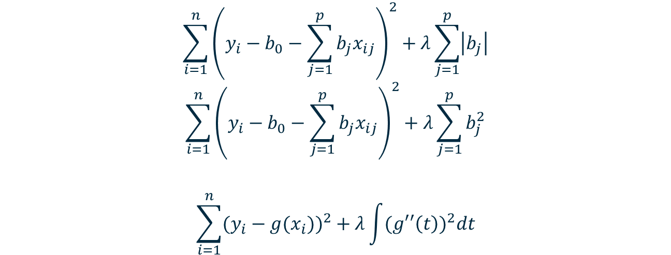
Ridge/Lasso Regression to Smoothing Splines: Cost Functions
$$\sum_{i=1}^{n}{{\left(y_{i}−b_{0}−\sum_{j=1}^{p}{b_{j}x_{ij}}\right)}^{2}}+λ\sum_{j=1}^{p}{\left|b_{j}\right|}$$
$$\sum_{i=1}^{n}{{\left(y_{i}−b_{0}−\sum_{j=1}^{p}{b_{j}x_{ij}}\right)}^{2}}+λ\sum_{j=1}^{p}{b_{j}^{2}}$$
$$\sum_{i=1}^{n}{{(y_{i}−g(x_{i}))}^{2}}+λ\int{{(g′′\left(t\right))}^{2}dt}$$
$$λ≥0$$
Find some function g(x) that minimizes this cost function!

Slide 55
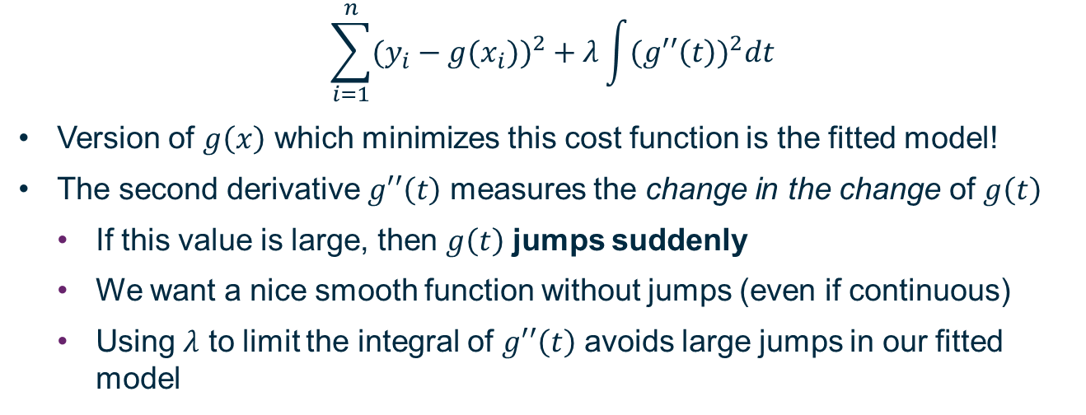
Limiting Second Derivative of Model Fit
$$\sum_{i=1}^{n}{{(y_{i}−g(x_{i}))}^{2}}+λ\int{{(g′′\left(t\right))}^{2}dt}$$
Version of $g\left(x\right)$ which minimizes this cost function is the fitted model!
The second derivative $g′′\left(t\right)$ measures the change in the change of $g\left(t\right)$
If this value is large, then $g\left(t\right)$ jumps suddenly
We want a nice smooth function without jumps (even if continuous)
Using $λ$ to limit the integral of $g′′\left(t\right)$ avoids large jumps in our fitted model

Slide 56
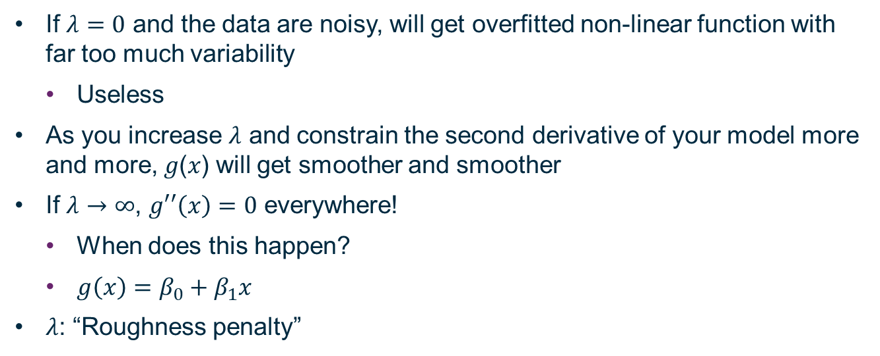

How does $g\left(x\right)$ change with changing $λ$?
If $λ=0$ and the data are noisy, will get overfitted non-linear function with far too much variability
Useless
As you increase $λ$ and constrain the second derivative of your model more and more, 𝑔(𝑥) will get smoother and smoother
If $λ→∞$, $g′′\left(x\right)=0$ everywhere!
When does this happen?
$g\left(x\right)=β_{0}+β_{1}x$
$λ$: “Roughness penalty”

Slide 57
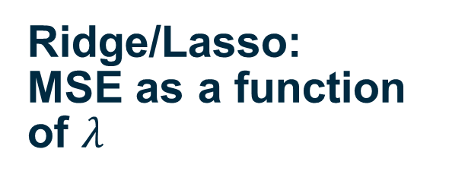
Ridge/Lasso: MSE as a function of $λ$

Slide 58
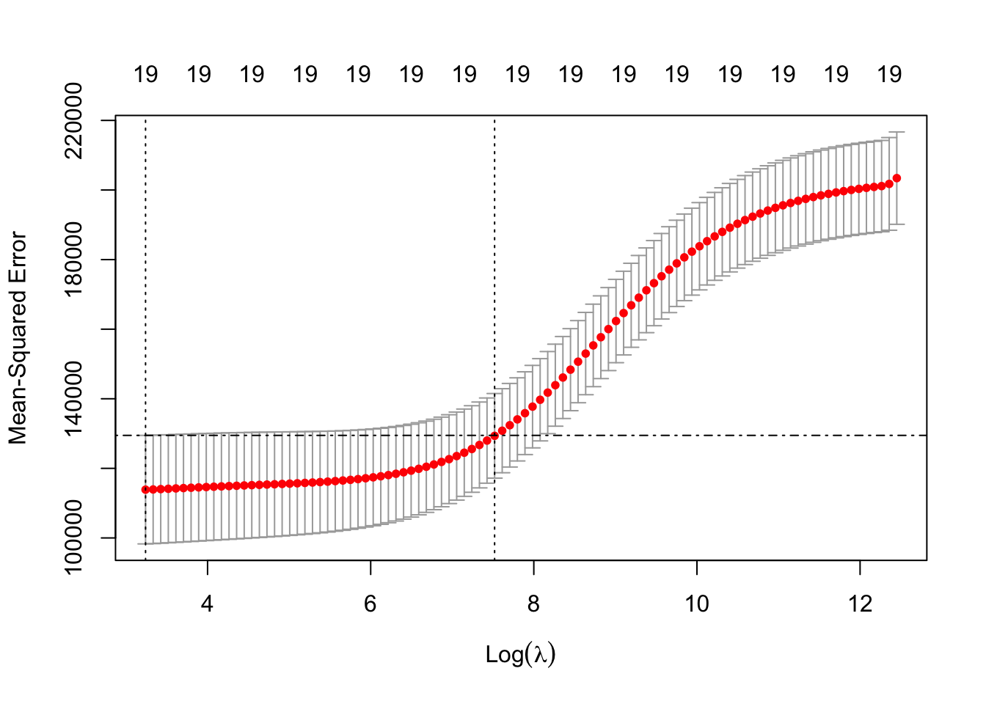
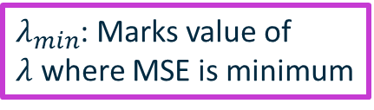
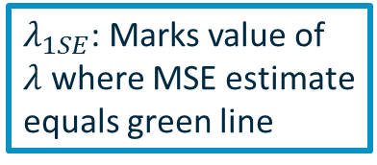
$λ_{min}$: Marks value of $λ$ where MSE is minimum
$λ_{1SE}$: Marks value of $λ$ where MSE estimate equals green line
Largest value of MSE that is still within 1 standard error of minimum MSE

